Slide 1


CSE3150 – Front-end Full Stack Development
Department of Computer Science Engineering
School of Engineering

Slide 2
Module I - Syllabus
[4 Sessions]
Introduction to Agile Methodology; Scrum Fundamentals; Scrum Roles, Artifacts and Rituals; DevOps – Architecture, Lifecycle, Workflow & Principles; DevOps Tools Overview – Jenkins, Docker, Kubernetes.Review of GIT source control.
HTML5 – Syntax, Attributes, Events, Web Forms 2.0, Web Storage, Canvas, Web Sockets; CSS3 – Colors, Gradients, Text, Transform
Assignment: Develop a website for managing HR policies of a department.

Slide 3
HTML SEMANTIC ELEMENTS

Slide 4
HTML5 Semantic Elements
Why are they needed?
One substantial problem with modern, pre-HTML5 semantic markup:
most complex web sites are absolutely packed solid with <div> elements.
Unfortunately, all these <div> elements can make the resulting markup confusing and hard to modify.
Developers typically try to bring some sense and order to the <div> chaos by using id or class names that provide some clue as to their meaning.

Slide 5
Header and Footer
Most web site pages have a recognizable header and footer section.
Typically the header contains
the site logo
title (and perhaps additional subtitles or taglines)
horizontal navigation links, and
perhaps one or two horizontal banners.

Slide 6
Header and Footer
The typical footer contains less important material, such as
smaller text versions of the navigation,
copyright notices,
information about the site’s privacy policy, and
perhaps twitter feeds or links to other social sites.

Slide 7
Header and Footer
Both the HTML5 <header> and <footer> element can be used not only for page headers and footers, they can also be used for header and footer elements within other HTML5 containers, such as <article> or <section>.
<header>
<img src="logo.gif" alt="logo" />
<h1>Fundamentals of Web Development</h1>
...
</header>
<article>
<header>
<h2>HTML5 Semantic Structure Elements </h2>
<p>By <em>Randy Connolly</em></p>
<p><time>September 30, 2012</time></p>
</header>
...
</article>

Slide 8
Heading Groups
The <hgroup> element can be used to group related headings together within one container.
<header>
<hgroup>
<h1>Chapter Two: HTML 1</h1>
<h2>An Introduction</h2>
</hgroup>
</header>
<article>
<hgroup>
<h2>HTML5 Semantic Structure Elements </h2>
<h3>Overview</h3>
</hgroup>
</article>

Slide 9
Navigation
The <nav> element represents a section of a page that contains links to other pages or to other parts within the same page.
Like the other new HTML5 semantic elements, the browser does not apply any special presentation to the <nav> element.
The <nav> element was intended to be used for major navigation blocks, presumably the global and secondary navigation systems.

Slide 10
Navigation
<header>
<img src="logo.gif" alt="logo" />
<h1>Fundamentals of Web Development</h1>
<nav role="navigation">
<ul>
<li><a href="index.html">Home</a></li>
<li><a href="about.html">About Us</a></li>
<li><a href="browse.html">Browse</a></li>
</ul>
</nav>
</header>

Slide 11
Articles and Sections
<article> <section>
The <article> element represents a section of content that forms an independent part of a document or site; for example, a magazine or newspaper article, or a blog entry.
The <section> element represents a section of a document, typically with a title or heading.

Slide 12
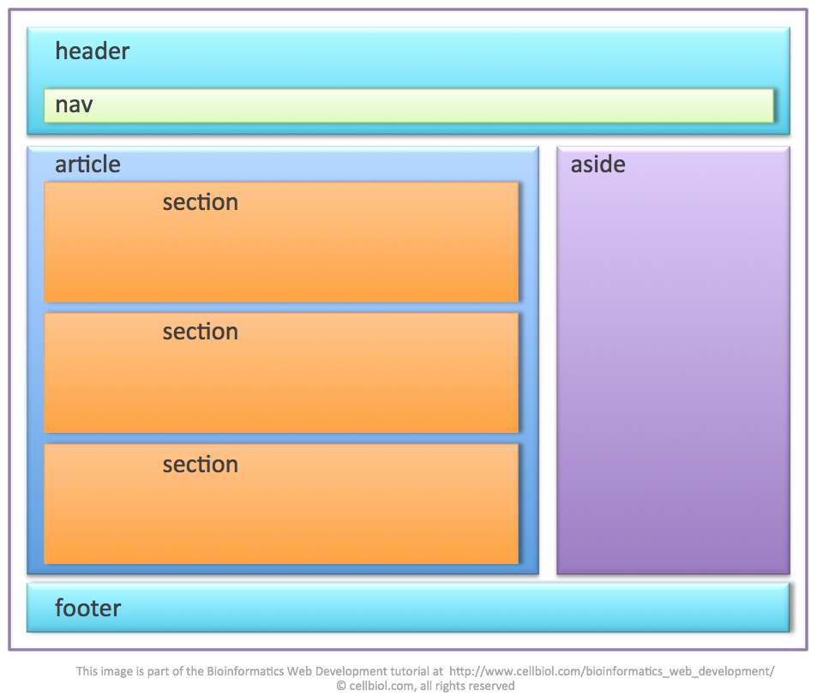
Articles and Sections
According to the W3C, <section> is a much broader element, while the <article> element is to be used for blocks of content that could potentially be read or consumed independently of the other content on the page.

Slide 13
Sections versus Divs
How to decide which to use
The WHATWG specification warns readers that the <section> element is not a generic container element. HTML already has the <div> element for such uses.
When an element is needed only for styling purposes or as a convenience for scripting, it makes sense to use the <div> element instead.
Another way to help you decide whether or not to use the <section> element is to ask yourself if it is appropriate for the element's contents to be listed explicitly in the document's outline.
If so, then use a <section>; otherwise use a <div>.

Slide 14
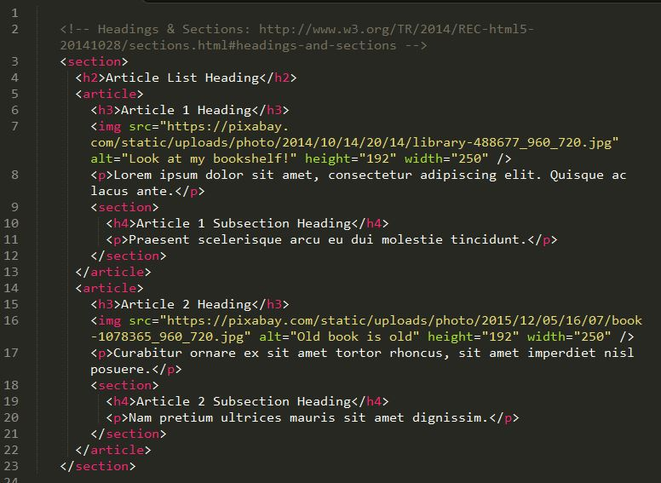

Slide 15
<!DOCTYPE html>
<html>
<body>
<article>
<h1>What Does WWF Do?</h1>
<p>WWF's mission is to stop the degradation of our planet's natural environment, and build a future in which humans live in harmony with nature.</p>
</article>
</body>
</html>

Slide 16
Figure and Figure Captions
<figure> <figcaption>
The W3C Recommendation indicates that the <figure> element can be used not just for images but for any type of essential content that could be moved to a different location in the page or document and the rest of the document would still make sense.

Slide 17
Figure and Figure Captions
Note however …
The <figure> element should not be used to wrap every image.
For instance, it makes no sense to wrap the site logo or non-essential images such as banner ads and graphical embellishments within <figure> elements.
Instead, only use the <figure> element for circumstances where the image (or other content) has a caption and where the figure is essential to the content but its position on the page is relatively unimportant.

Slide 18
Aside
The <aside> element is similar to the <figure> element in that it is used for marking up content that is separate from the main content on the page.
But while the <figure> element was used to indicate important information whose location on the page is somewhat unimportant, the <aside> element “represents a section of a page that consists of content that is tangentially related to the content around the aside element.”
The <aside> element could thus be used for sidebars, pull quotes, groups of advertising images, or any other grouping of non-essential elements.

Slide 19
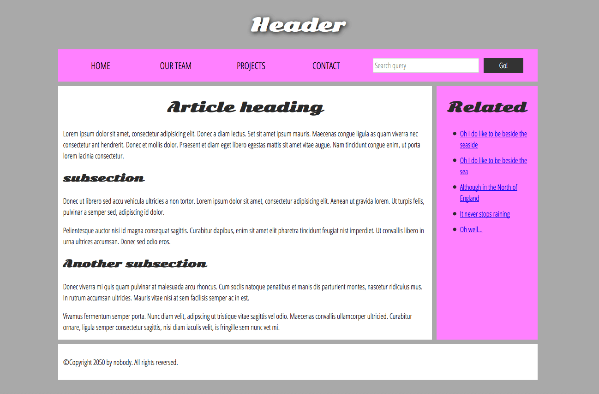

Slide 20
Event Attributes
HTML has the ability to let events trigger actions in a browser, like starting a JavaScript when a user clicks on an element.
Attribute | Description
onafterprint | Script to be run after the document is printed
onbeforeprint | Script to be run before the document is printed
onbeforeunload | Script to be run when the document is about to be unloaded
onerror | Script to be run when an error occurs
onhashchange | Script to be run when there has been changes to the anchor part of the a URL
onload | Fires after the page is finished loading
onmessage | Script to be run when the message is triggered
onoffline | Script to be run when the browser starts to work offline
ononline | Script to be run when the browser starts to work online
onpagehide | Script to be run when a user navigates away from a page
onpageshow | Script to be run when a user navigates to a page
onpopstate | Script to be run when the window's history changes
onresize | Fires when the browser window is resized
onstorage | Script to be run when a Web Storage area is updated
onunload | Fires once a page has unloaded (or the browser window has been closed)

Slide 21
Attribute | Description
onafterprint | Script to be run after the document is printed
onbeforeprint | Script to be run before the document is printed
onbeforeunload | Script to be run when the document is about to be unloaded
onerror | Script to be run when an error occurs
onhashchange | Script to be run when there has been changes to the anchor part of the a URL
onload | Fires after the page is finished loading
onmessage | Script to be run when the message is triggered
onoffline | Script to be run when the browser starts to work offline
ononline | Script to be run when the browser starts to work online
onpagehide | Script to be run when a user navigates away from a page
onpageshow | Script to be run when a user navigates to a page
onpopstate | Script to be run when the window's history changes
onresize | Fires when the browser window is resized
onstorage | Script to be run when a Web Storage area is updated
onunload | Fires once a page has unloaded (or the browser window has been closed)

Slide 22
Try to resize the browser window.
<!DOCTYPE html>
<html>
<body onresize="myFunction()">
<p>Try to resize the browser window.</p>
<script>
function myFunction() {
alert("You have changed the size of the browser window!");
}
</script>
</body></html>

Slide 23
HTML Canvas
HTML canvas is an HTML element that provides a drawing surface for creating graphics and animations with JavaScript.
Canvas elements have attributes such as width and height that define the size of the drawing area.
The Canvas API provides a set of methods and properties for drawing shapes, text, and images on the canvas, as well as manipulating colors, gradients, and patterns.
Canvas can be used to create a wide range of visual content, such as charts, graphs, diagrams, animations, games, and more.
Canvas is highly customizable with CSS styles that control the appearance of the canvas element and its contents.

Slide 24
HTML Canvas (contd..)
Canvas supports interactivity and animation, allowing you to create dynamic, user-driven content that responds to user input.
Canvas can be integrated with other web technologies, such as HTML, CSS, and JavaScript, to create sophisticated web applications.
Canvas is supported by most modern web browsers, including Chrome, Firefox, Safari, and Edge.
Canvas requires some programming knowledge, as you need to write JavaScript code to create and manipulate graphics on the canvas.
There are also many libraries and frameworks available that can help you create more complex and advanced canvas projects, such as Three.js, D3.js, and p5.js.

Slide 25
Example
<!DOCTYPE html>
<html>
<body>
<canvas id="myCanvas" width="300" height="150" style="border:1px solid #d3d3d3;">
Your browser does not support the HTML5 canvas tag.</canvas>
<script>
var c = document.getElementById("myCanvas");
var ctx = c.getContext("2d");
ctx.fillStyle = "#FF0000";
ctx.fillRect(20, 20, 150, 100);
</script>
</body>
</html>

Slide 26
WebSockets
WebSockets is a next-generation bidirectional communication technology for web applications which operates over a single socket and is exposed via a JavaScript interface in HTML 5 compliant browsers.
Once you get a Web Socket connection with the web server, you can send data from browser to server by calling a send() method, and receive data from server to browser by an onmessage event handler.

Slide 27
WebSockets
Following is the API which creates a new WebSocket object.
var Socket = new WebSocket(url, [protocal] ); Here first argument, url, specifies the URL to which to connect.
The second attribute, protocol is optional, and if present, specifies a sub-protocol that the server must support for the connection to be successful.

Slide 28
Transform Property
The transform property applies a 2D or 3D transformation to an element.
Some common transform functions that can be used with the transform property include:
rotate: Rotates the element by a specified angle.
scale: Scales the element by a specified factor.
skew: Skews the element by a specified angle.
translate: Moves the element by a specified distance.

Slide 29
The translate() Method
The translate() method moves an element from its current position:
<html> <head> <style>
div {
width: 300px;
height: 100px;
background-color: yellow;
border: 1px solid black;
transform: translate(50px,100px);
}
</style> </head> <body>
<h1>The translate() Method</h1>
<p>The translate() method moves an element from its current position:</p>
<div>
This div element is moved 50 pixels to the right, and 100 pixels down from its current position.
</div> </body></html>

Slide 30
CSS Gradients
CSS gradients let you display smooth transitions between two or more specified colors.
CSS defines three types of gradients:
Linear Gradients (goes down/up/left/right/diagonally)
Radial Gradients (defined by their center)
Conic Gradients (rotated around a center point)

Slide 31
CSS Linear Gradients
To create a linear gradient you must define at least two color stops. Color stops are the colors you want to render smooth transitions among. You can also set a starting point and a direction (or an angle) along with the gradient effect.

Slide 32
Direction - Top to Bottom (this is default)
<!DOCTYPE html>
<html><head><style>
#grad1 {
height: 200px;
background-color: red; /* For browsers that do not support gradients */
background-image: linear-gradient(red, yellow);
}
</style></head><body>
<h1>Linear Gradient - Top to Bottom</h1>
<p>This linear gradient starts red at the top, transitioning to yellow at the bottom:</p>
<div id="grad1"></div>
</body></html>

Slide 33
HTML colors
HTML colors are specified with predefined color names, or with RGB, HEX, HSL, RGBA, or HSLA values.
HTML supports 140 standard color names.

Slide 34
<!DOCTYPE html>
<html> <body>
<h1 style="background-color:Tomato;">Tomato</h1>
<h1 style="background-color:Orange;">Orange</h1>
<h1 style="background-color:DodgerBlue;">DodgerBlue</h1>
<h1 style="background-color:MediumSeaGreen;">MediumSeaGreen</h1>
<h1 style="background-color:Gray;">Gray</h1>
<h1 style="background-color:SlateBlue;">SlateBlue</h1>
<h1 style="background-color:Violet;">Violet</h1>
<h1 style="background-color:LightGray;">LightGray</h1>
</body></html>

Slide 35
Color Values
In HTML, colors can also be specified using RGB values, HEX values, HSL values, RGBA values, and HSLA values.
The three <div> elements have their background color set with RGB, HEX, and HSL values:

Slide 36
<!DOCTYPE html>
<html><body>
<p>Same as color name "Tomato":</p>
<h1 style="background-color:rgb(255, 99, 71);">rgb(255, 99, 71)</h1>
<h1 style="background-color:#ff6347;">#ff6347</h1>
<h1 style="background-color:hsl(9, 100%, 64%);">hsl(9, 100%, 64%)</h1>
<p>Same as color name "Tomato", but 50% transparent:</p>
<h1 style="background-color:rgba(255, 99, 71, 0.5);">rgba(255, 99, 71, 0.5)</h1>
<h1 style="background-color:hsla(9, 100%, 64%, 0.5);">hsla(9, 100%, 64%, 0.5)</h1>
<p>In addition to the predefined color names, colors can be specified using RGB, HEX, HSL, or even transparent colors using RGBA or HSLA color values.</p>
</body></html>

Slide 37
INDEX
Introduction
web 1.0
web 2.0.
Comparison of Web1.0 and Web 2.0
Web 2.0 Technologies

Slide 38
Web Storage
With web storage, web applications can store data locally within the user's browser.
Before HTML5, application data had to be stored in cookies, included in every server request. Web storage is more secure, and large amounts of data can be stored locally, without affecting website performance.
Unlike cookies, the storage limit is far larger (at least 5MB) and information is never transferred to the server.
Web storage is per origin (per domain and protocol). All pages, from one origin, can store and access the same data

Slide 39
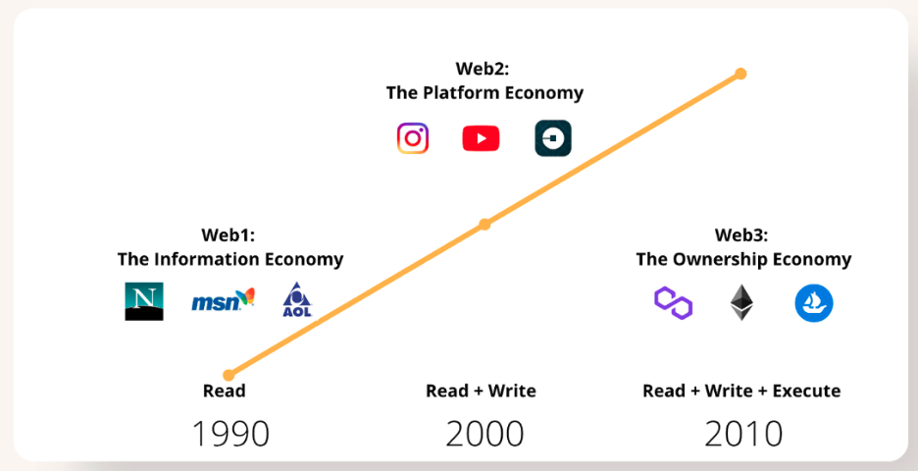
Evolution of WEB
The World Wide Web is the key tool used by billions of people to distribute information, read and create it, and connect with others over the internet. The web has evolved considerably over time, and its contemporary uses are almost unrecognizable from its inception. The development of the web is often classified into three stages: Web 1.0, Web 2.0, and Web 3.0.

Slide 40
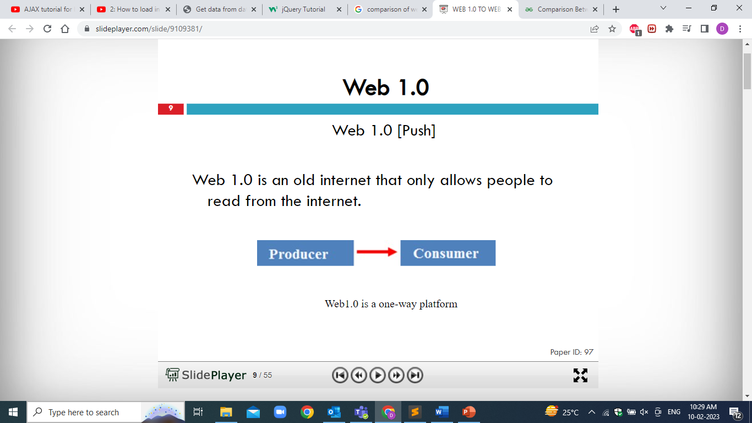

Slide 41
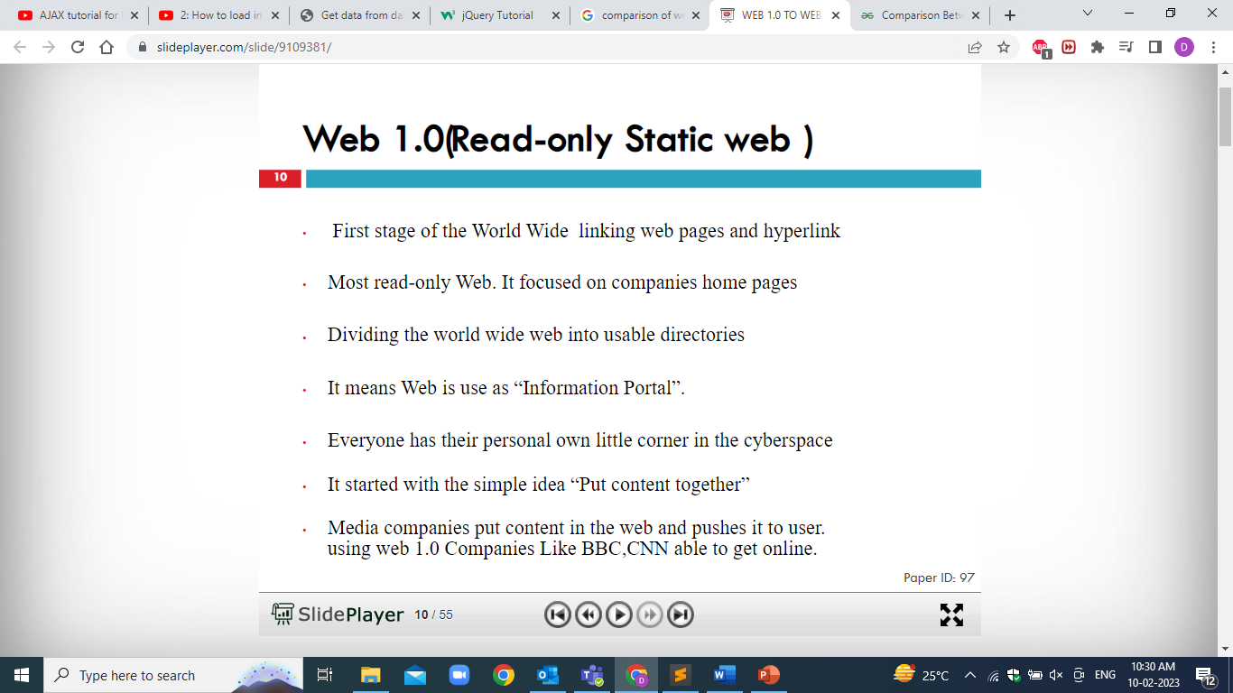

Slide 42
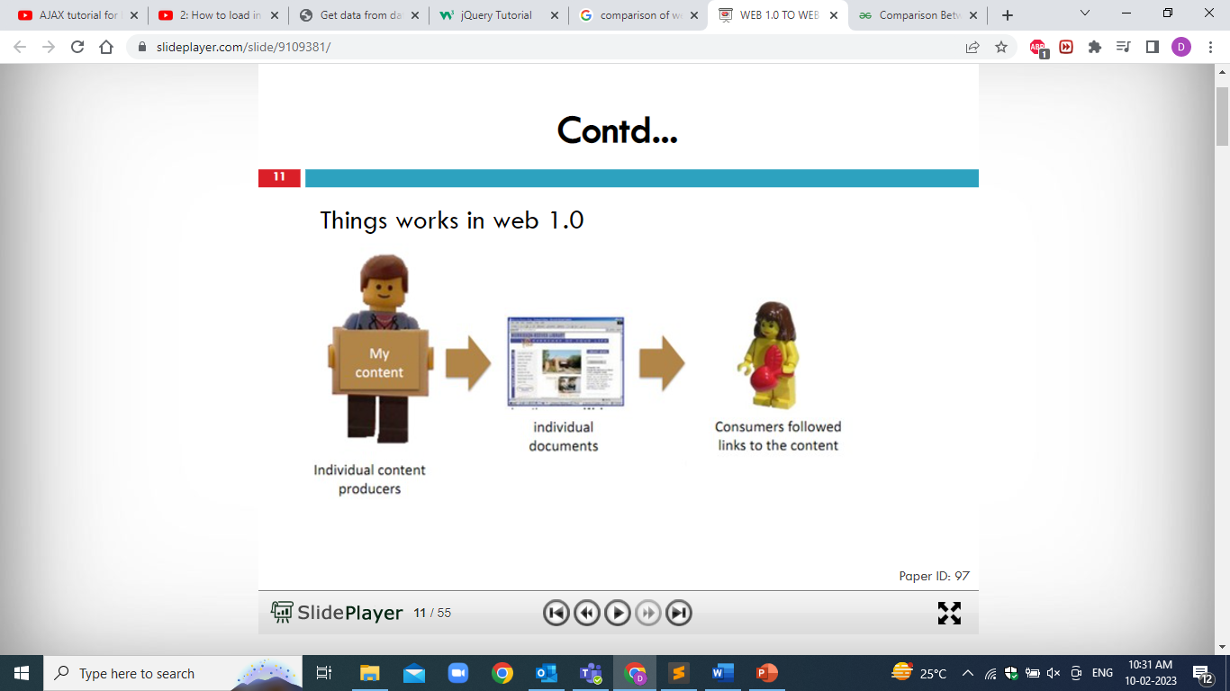

Slide 43
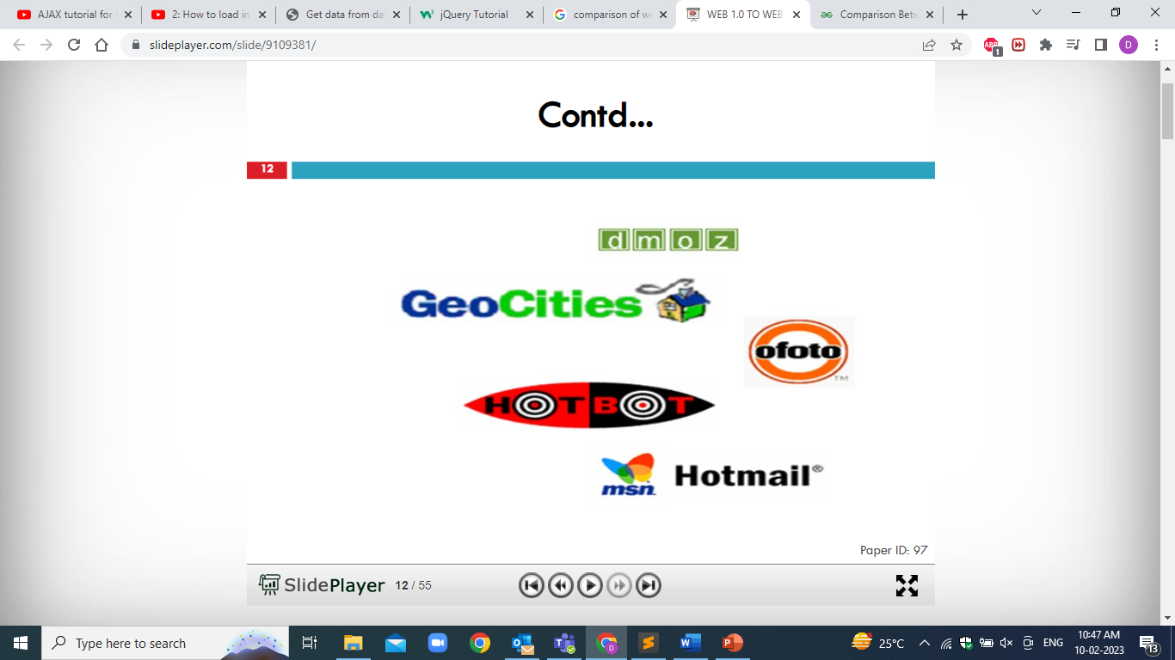

Slide 44
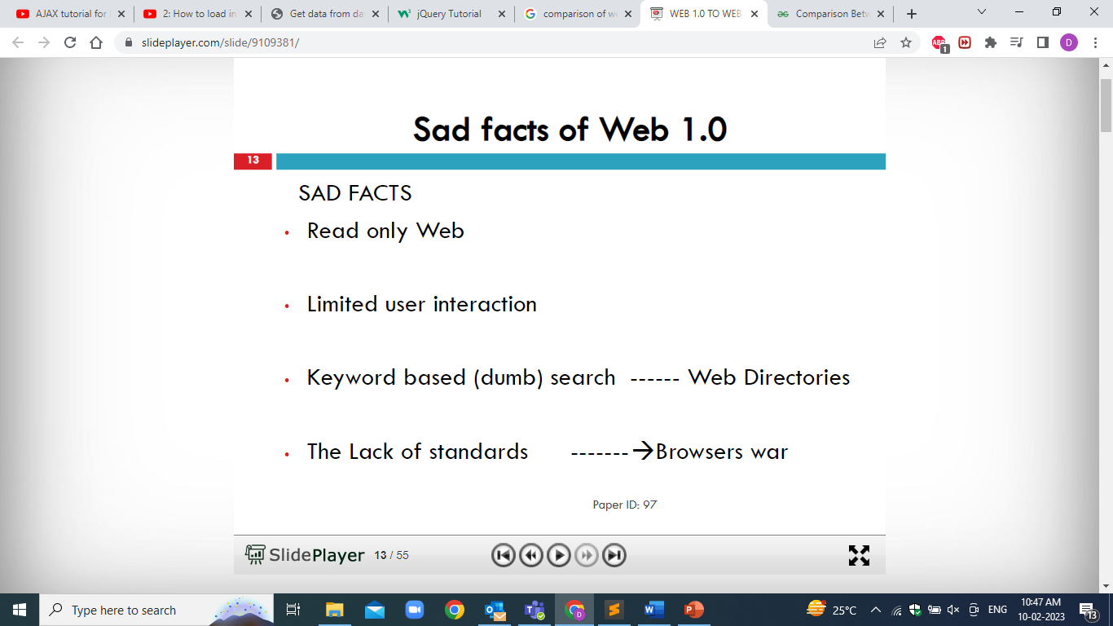

Slide 45
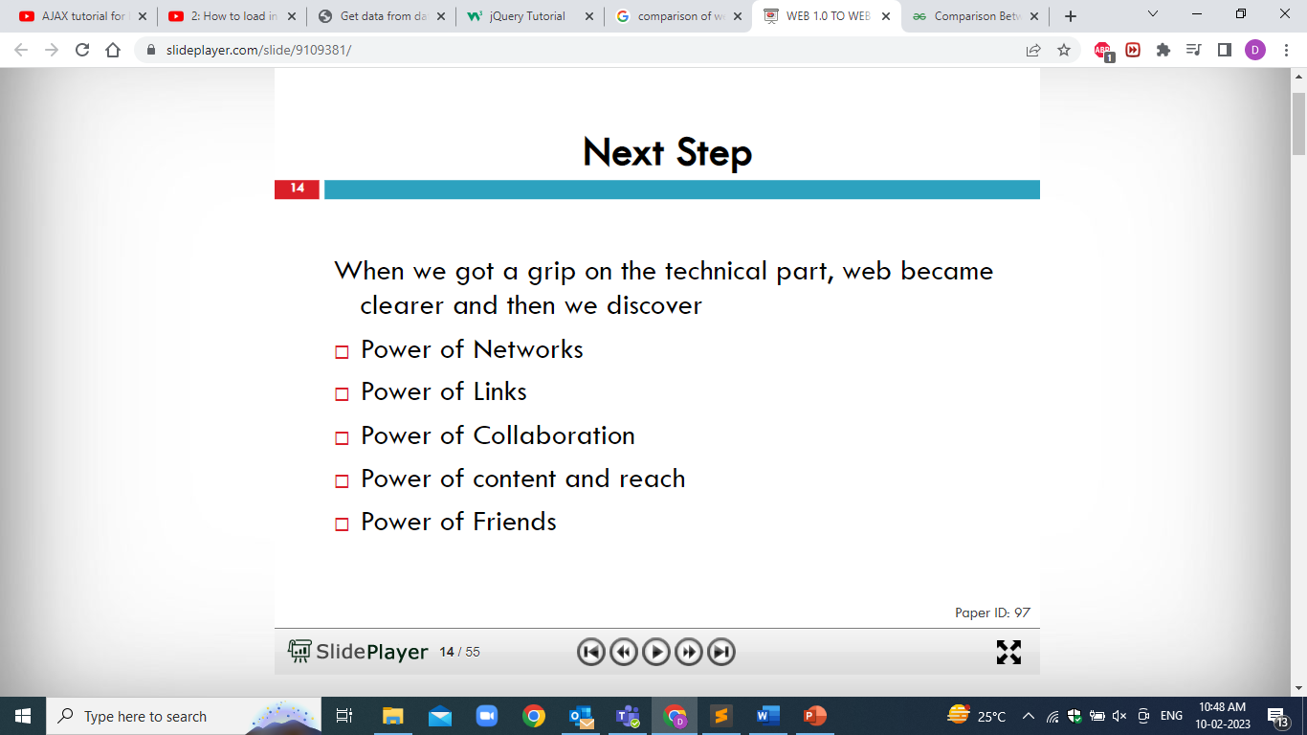

Slide 46
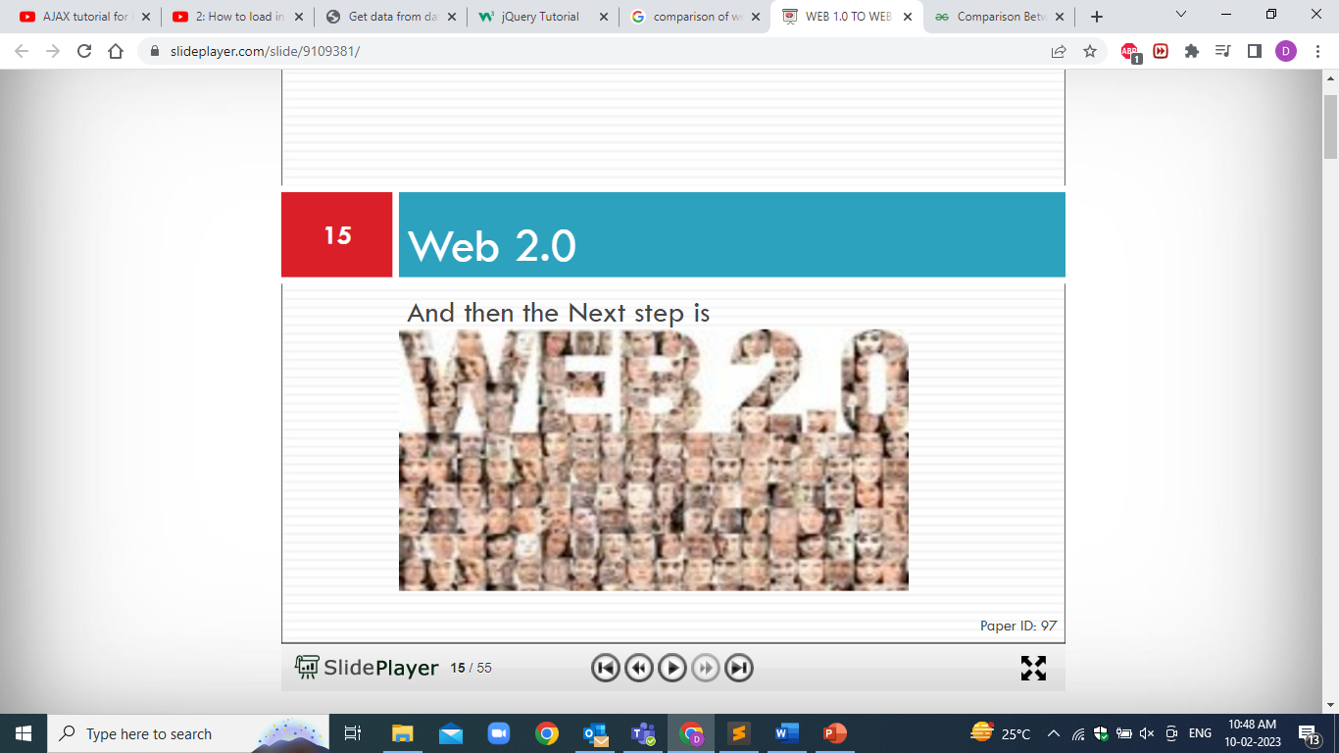

Slide 47
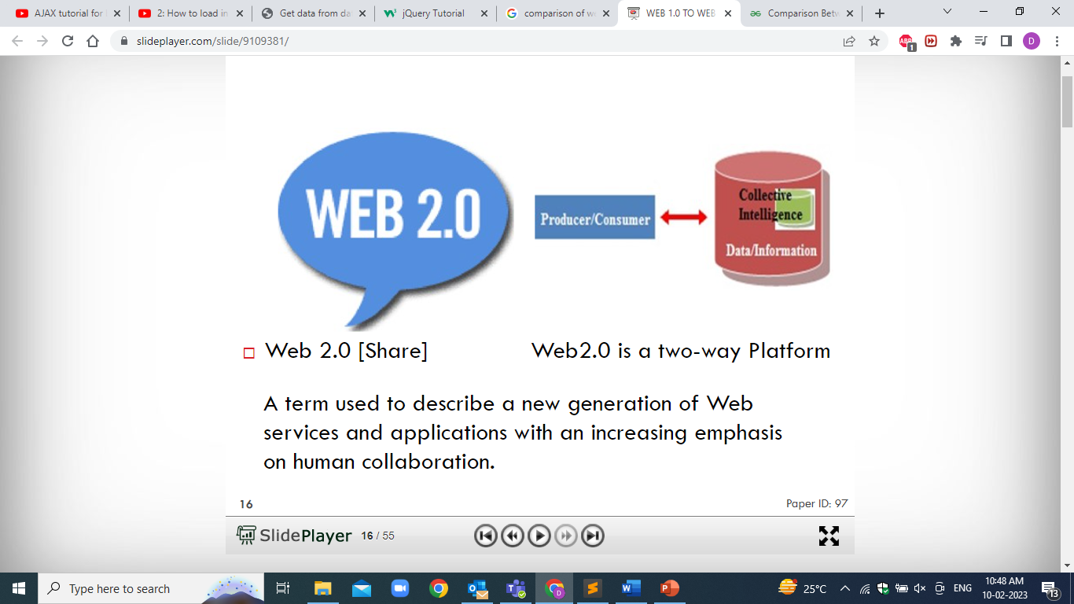

Slide 48
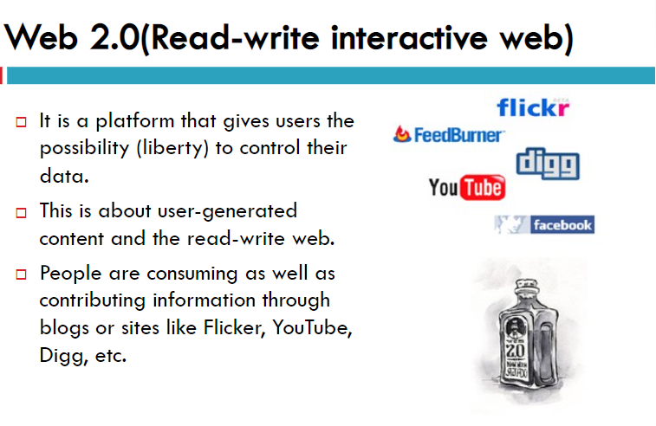

Slide 49
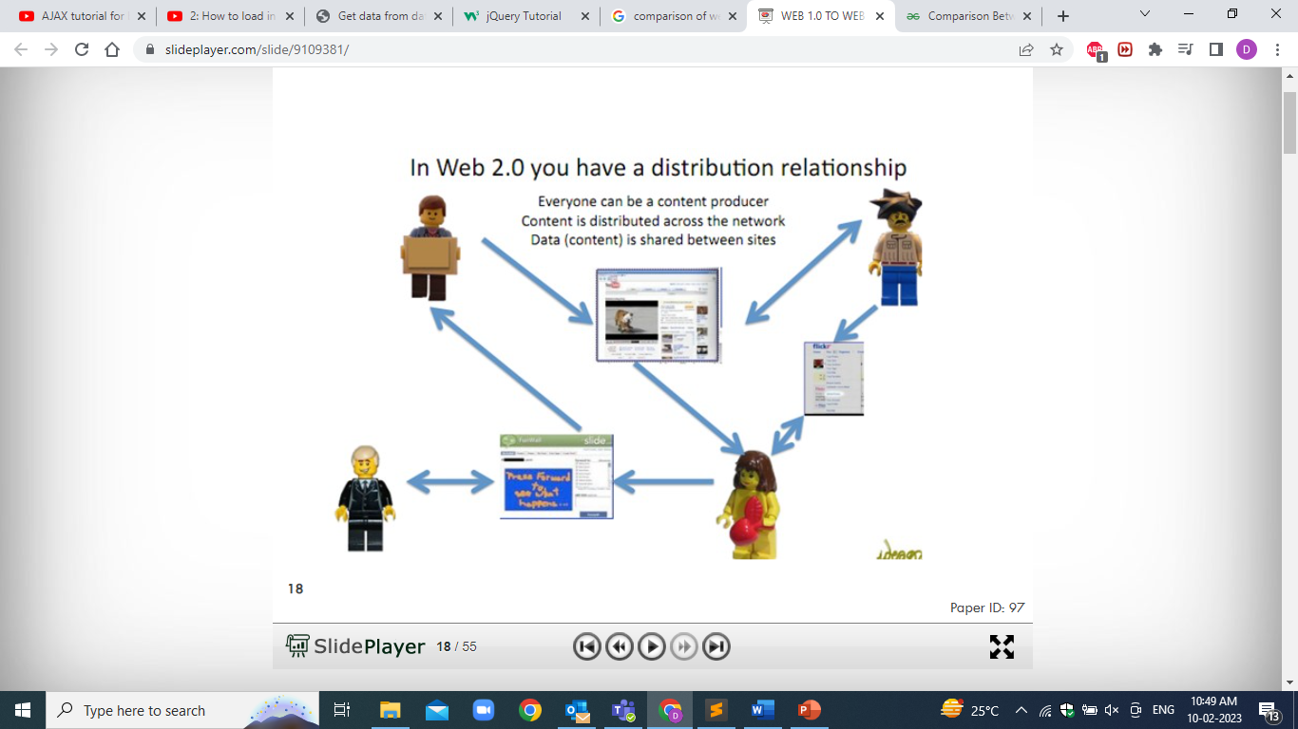

Slide 50
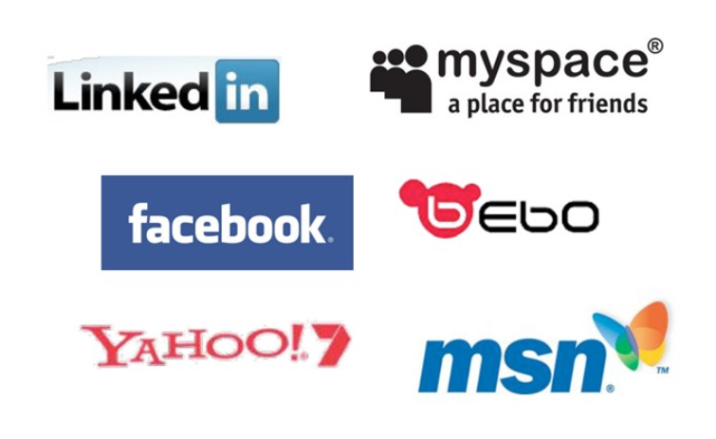

Slide 51


Slide 52
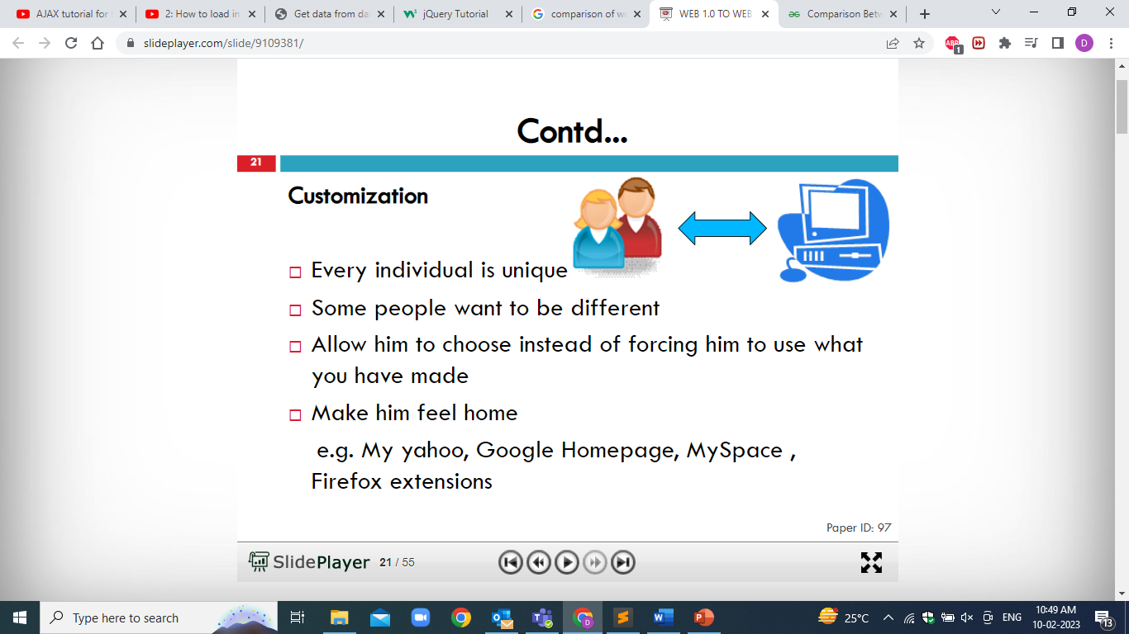

Slide 53
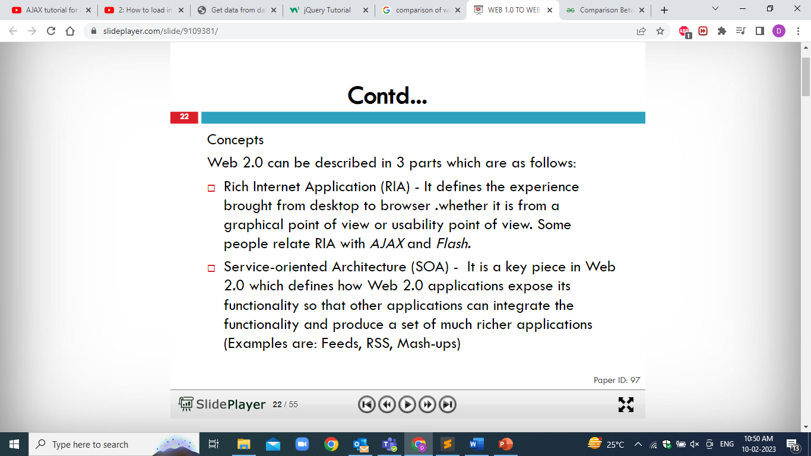

Slide 54
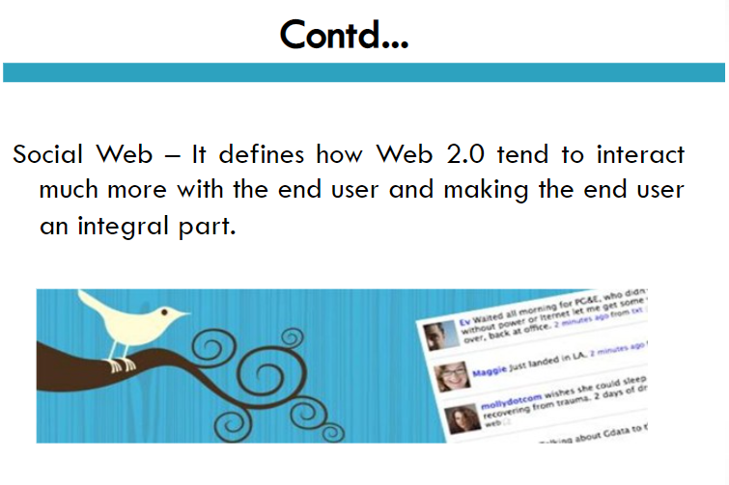

Slide 55
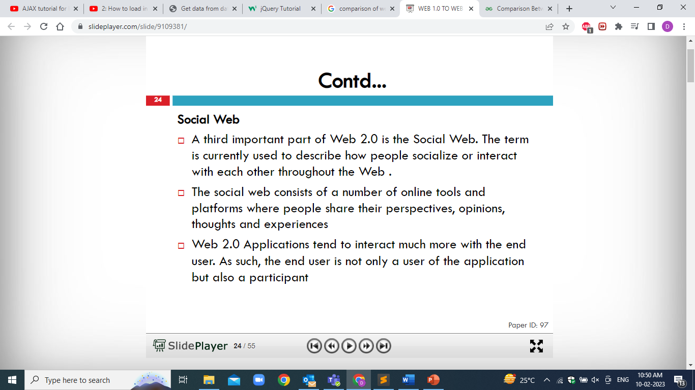

Slide 56
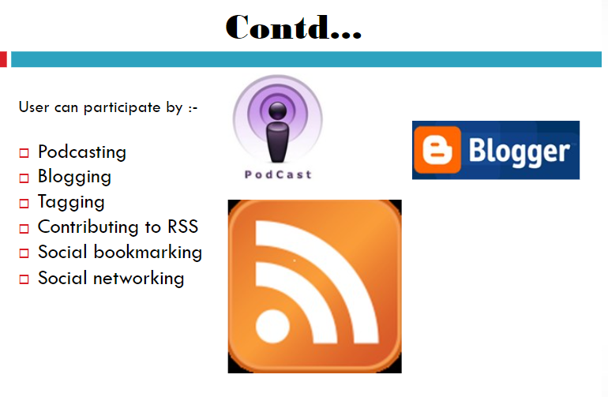

Slide 57
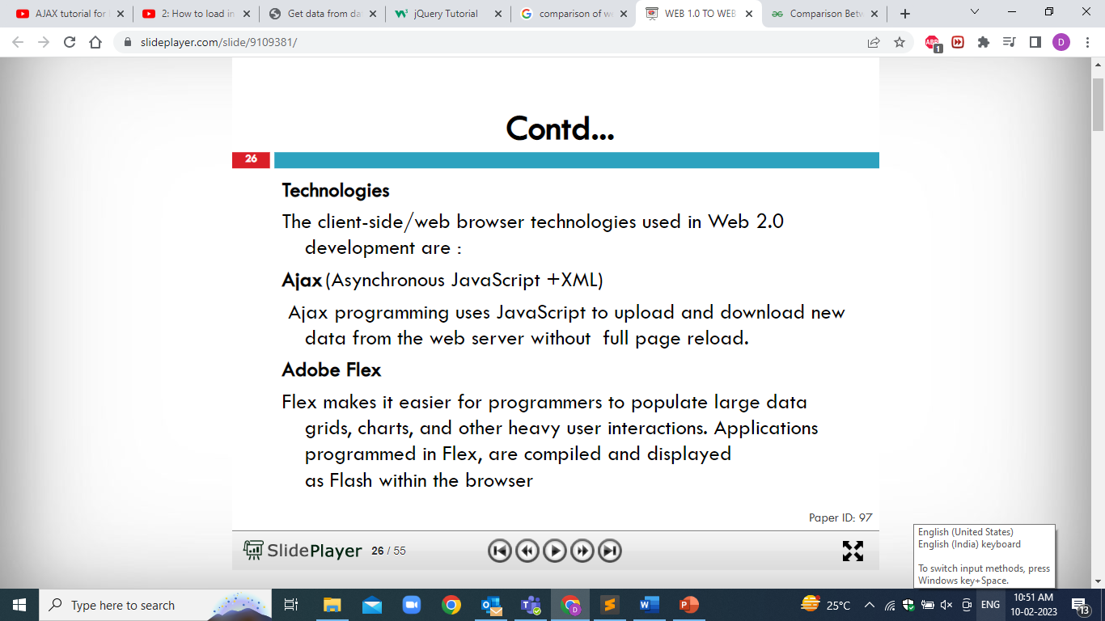

Slide 58
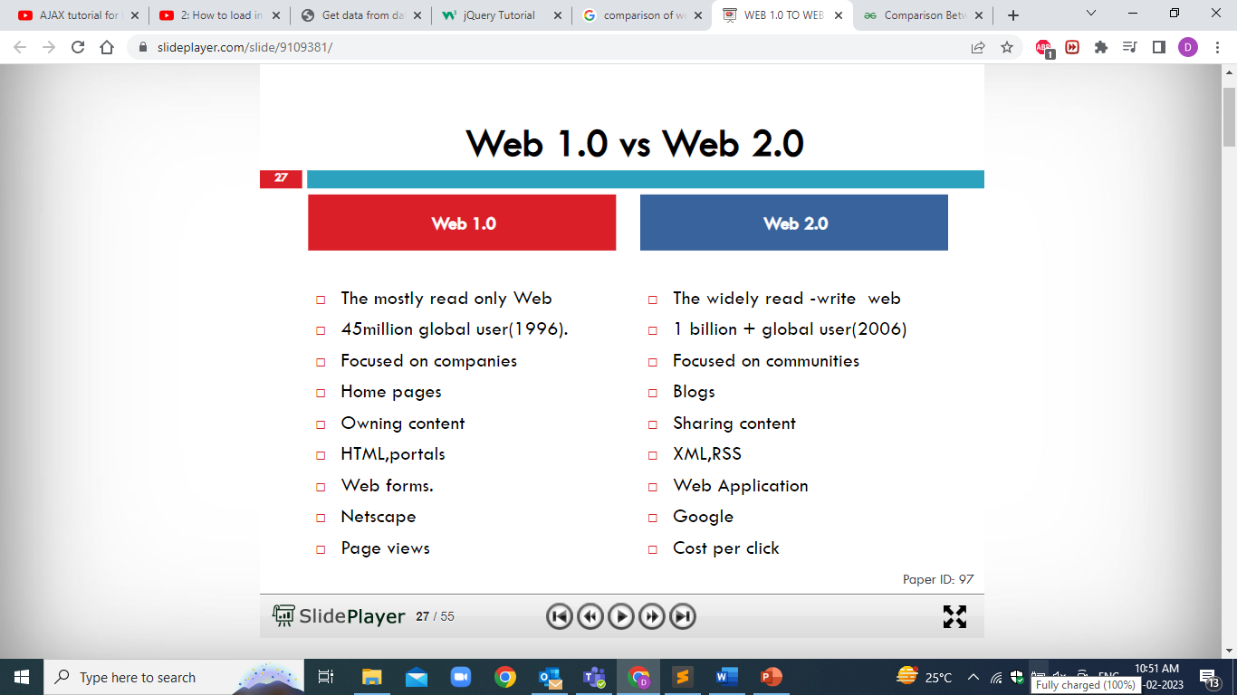

Slide 59
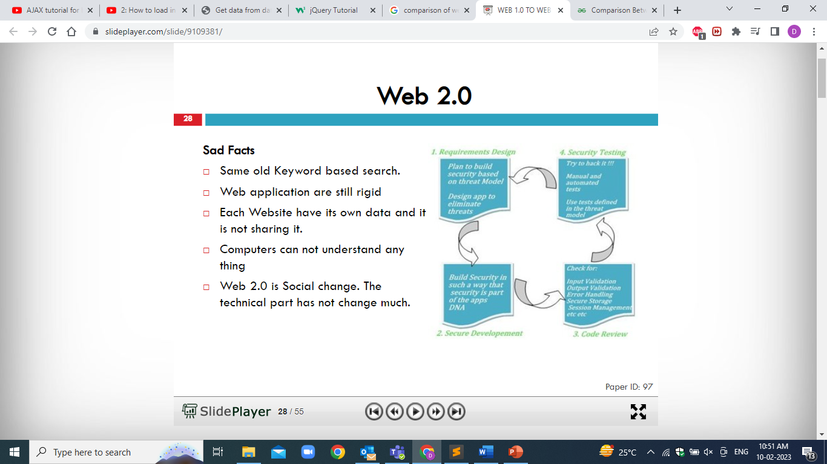

Slide 60


Web 2.0 Technologies

Slide 61
Existing Technologies
Web 1.0 Vs Web 2.0
E-mail - Offline
Static and Dynamic websites,
Forums
I-Pad and I-books
Blogs , Wikis
RSS aggregators
web conferencing
Instant messaging
R3 Access
Semantic web
Quick Response Code
Mobile Apps
MOOCs, LMS, Reference Management systems
Mp3.com --> Napster
Britannica Online --> Wikipedia
Personal websites --> blogging

Slide 62
Web 2.0 Concepts
Collaboration
Sharing
Ownership
Creation
Social Connection/Relationships
Participation
Decentralized
Notes:
62

Slide 63





Access to I-books using i-pad or Rolltop

Slide 64
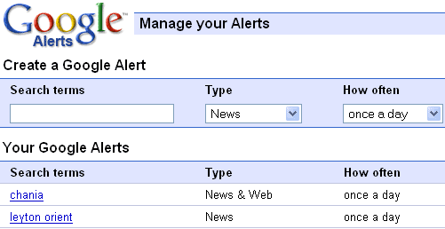
Information Alert using Google Alert
Library and Information Centers are offering a variety of additional services; among these are alert services which present requested information on recent publications, renewals of books, new arrivals of books and so on. Google also providing the online information alert service for their users.

Slide 65

Access to I-books using Chrome
Applications are advanced websites that are similar to other types of programs that install on computer. The main difference is that apps are accessed and used entirely within the browser.
Extensions are custom features and functionality that can add to Google Chrome. Unlike apps, they’re always available, no matter what website on.
Themes change the skin of the Google Chrome browser, to give it a bit more style and flair. Choose from hundreds of eye-popping themes.

Slide 66
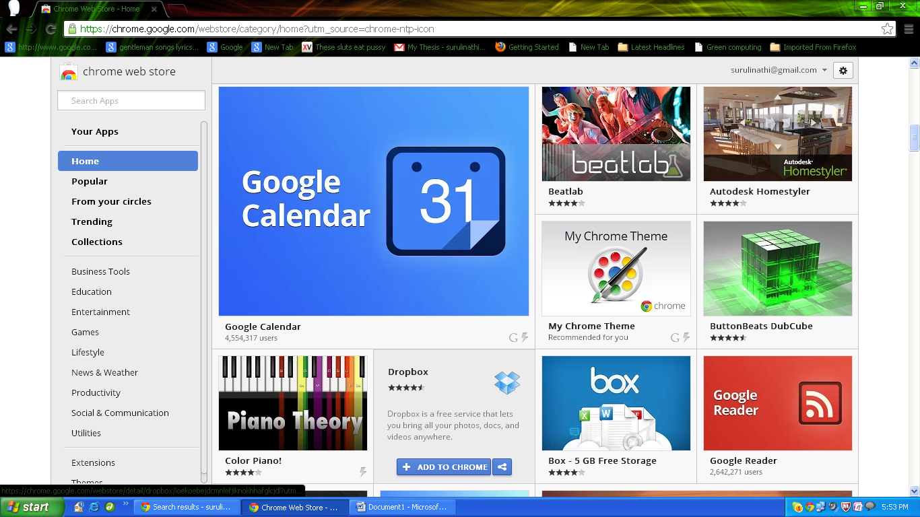
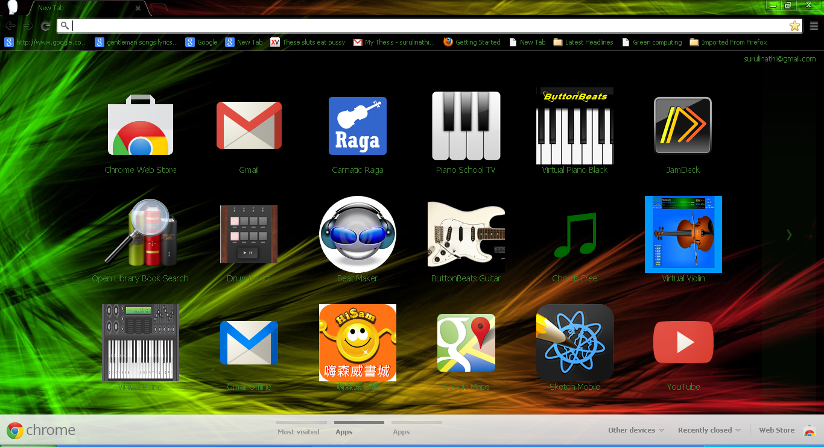
Web Applications in Chrome store

Slide 67
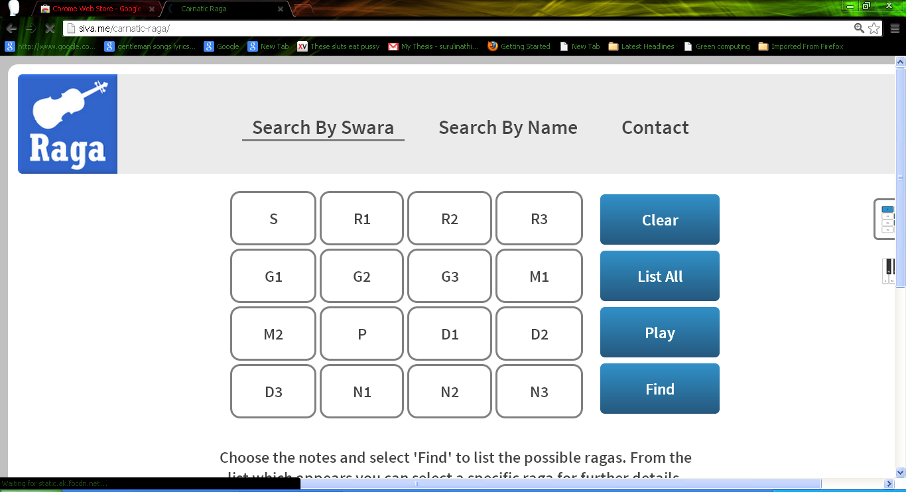
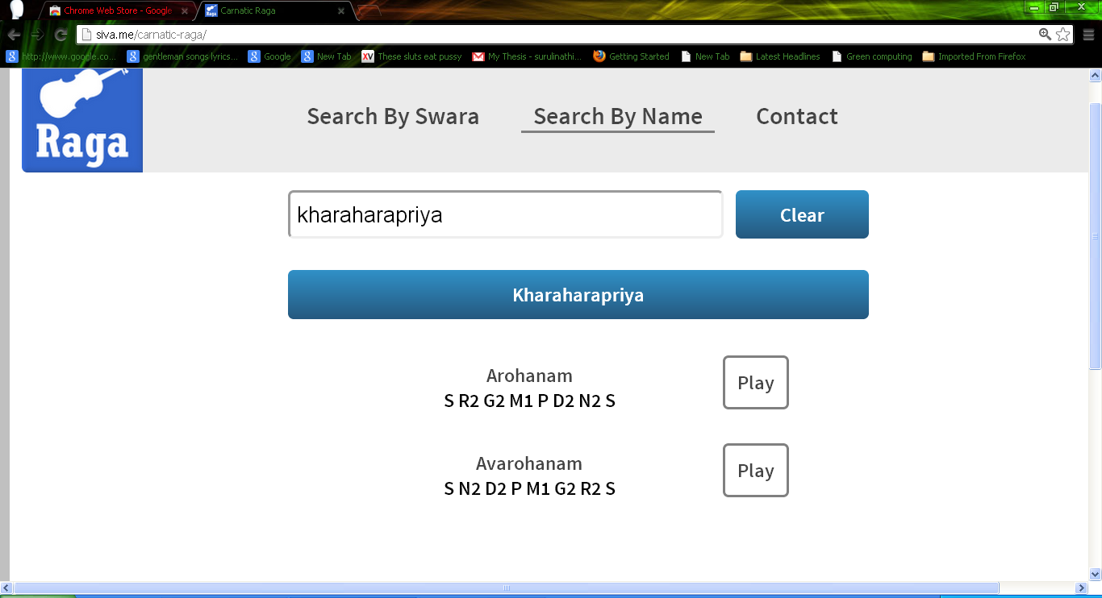
Carnatic Raga Software

Slide 68
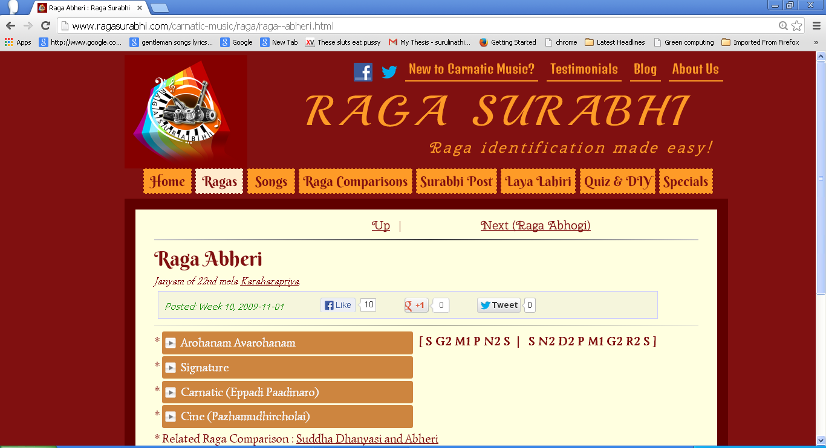

Slide 69
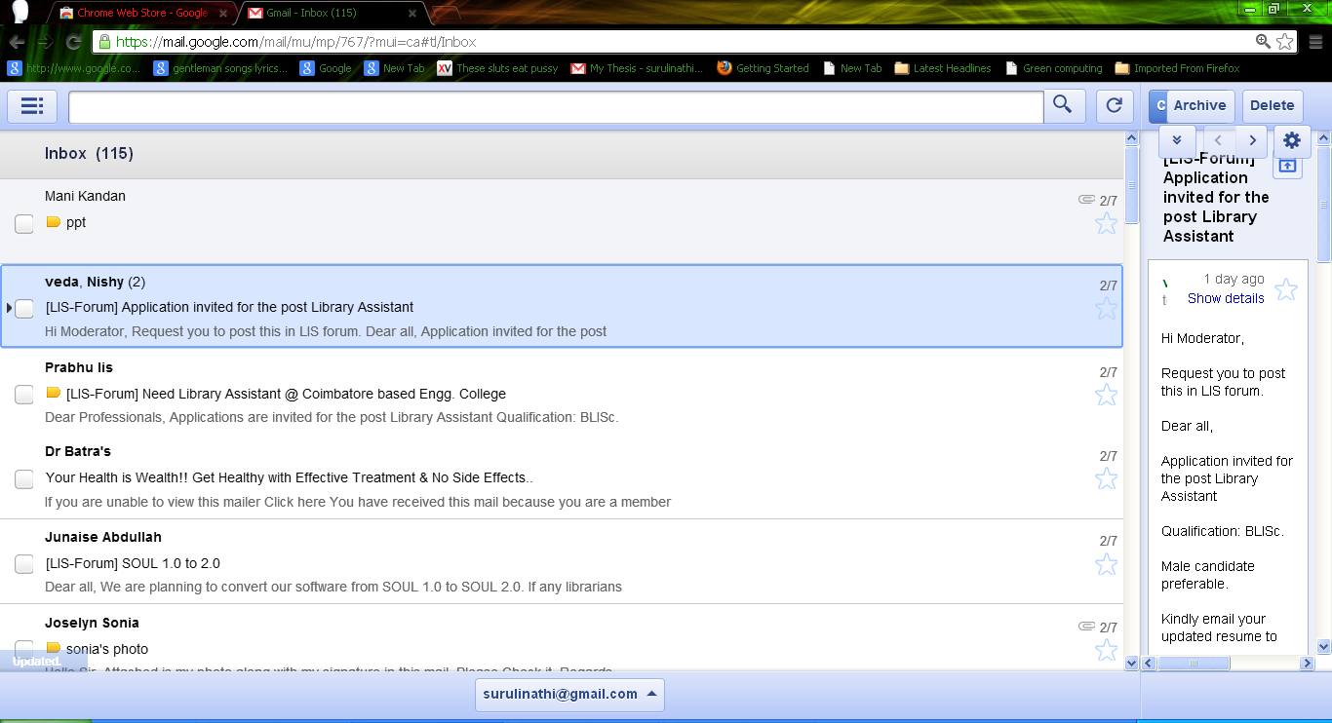
Gmail Offline

Slide 70
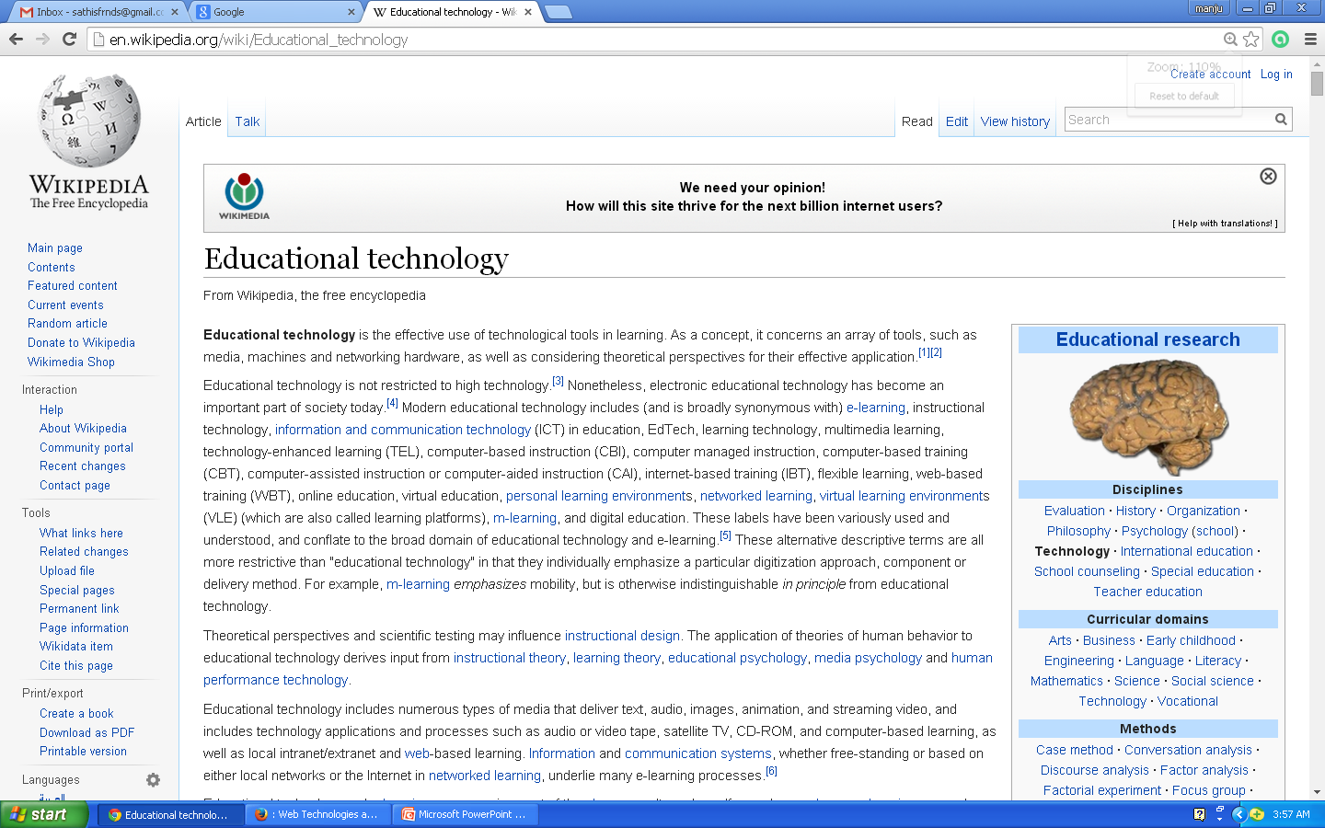
Wiki
A wiki invites all users to edit any page or to create new pages within the wiki Web site.

Slide 71
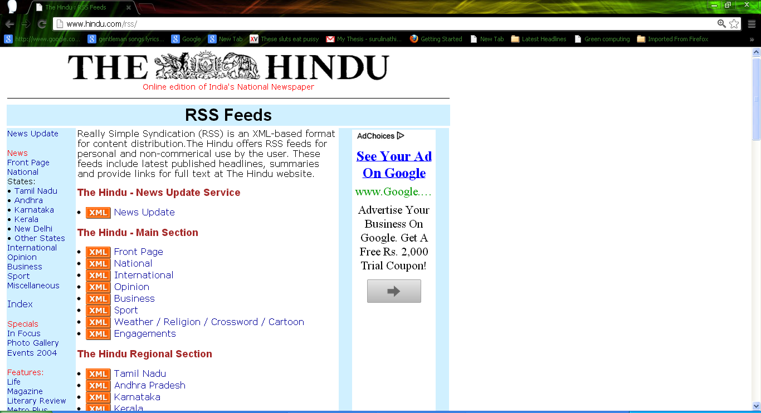
Rich Site Summary
RSS is a structured XML-based metadata schema used to distribute news items through a web medium.
RSS is a family of Web feed formats used to publish frequently updated content .

Slide 72
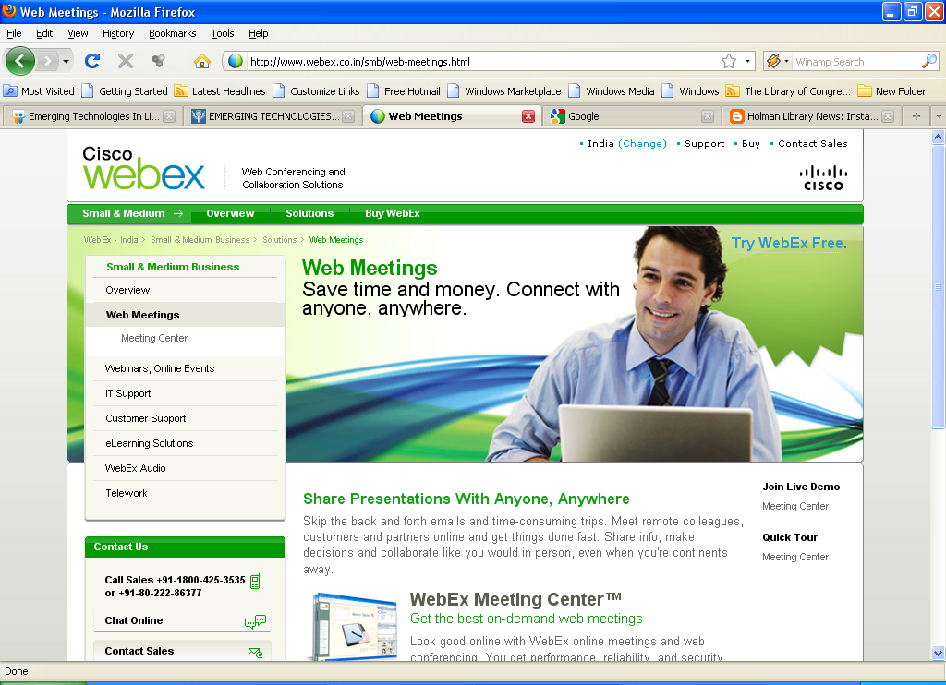
Web Conferencing
Web conferencing is used to conduct live meetings, training, or presentations via the Internet.
Slide show presentations
Live or Streaming video - where full motion webcam.
Meeting Recordings

Slide 73
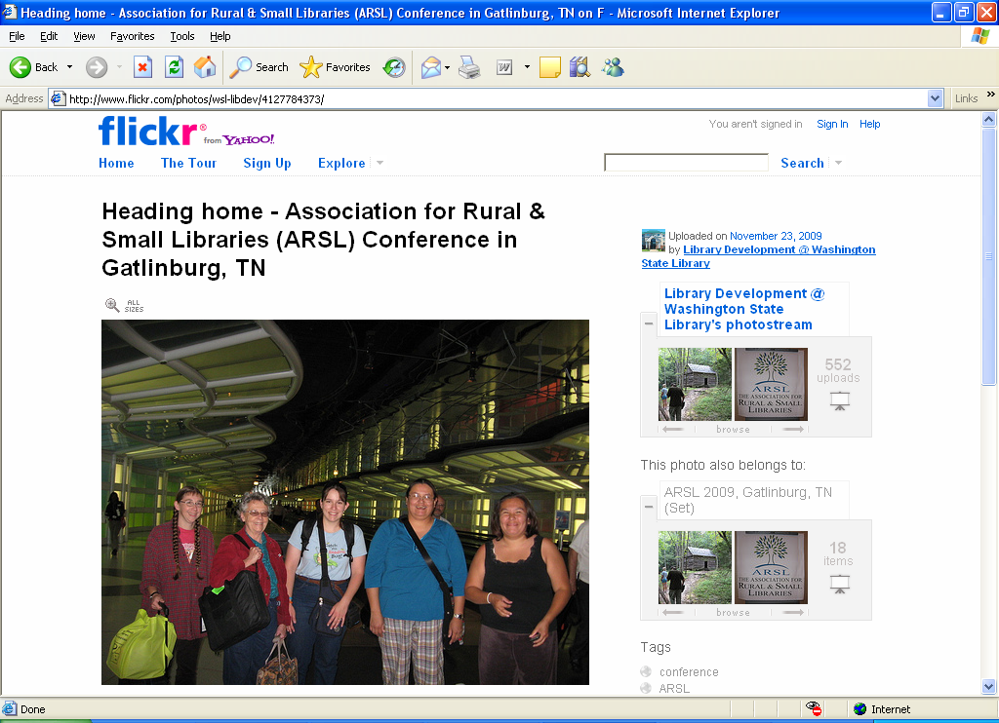
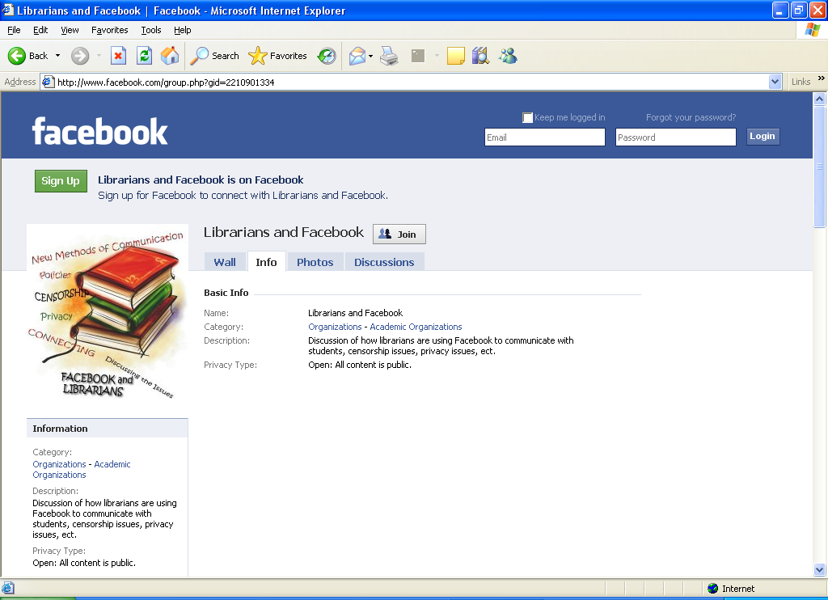

Slide 74

Content Management System
A content management system (CMS) is a system used to manage the content of a Web site.
Content Management Systems:-

Slide 75
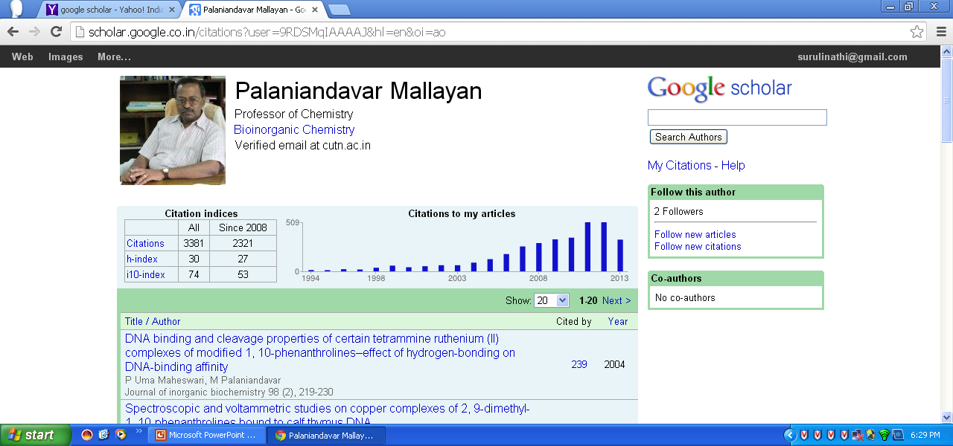
Compilation of Citation profile using Google Scholar

Slide 76
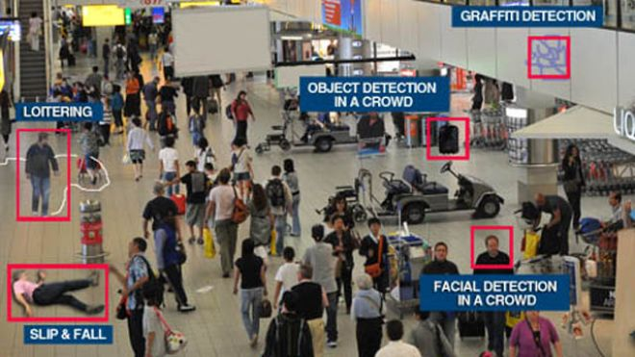
Smart Surveillance System
As smart surveillance technology becomes a critical component in security infrastructures.
This concept considers the example of smart surveillance in an Library security environment.

Slide 77
Free Websites
Geocities
Google Pages
Webs
Weebly
Webnode
Wix
Big Rock
Yola and so on

Slide 78
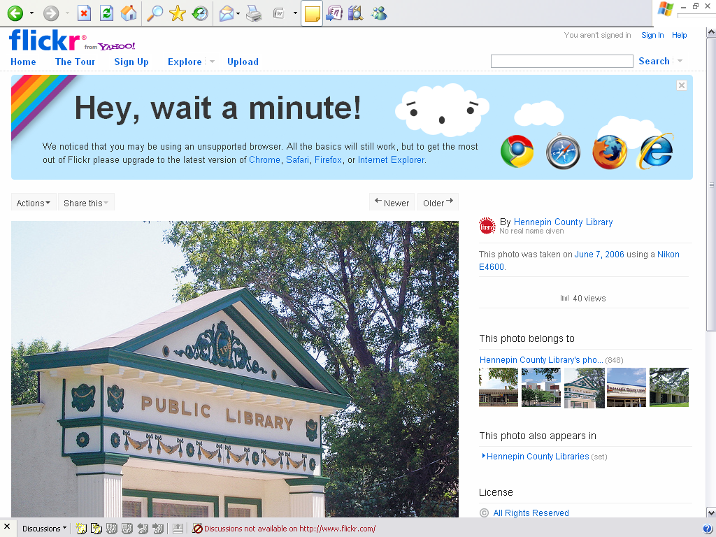
FLICKR
Flickr is an image hosting and video hosting website
The best online photo management and sharing application in the world.

Slide 79
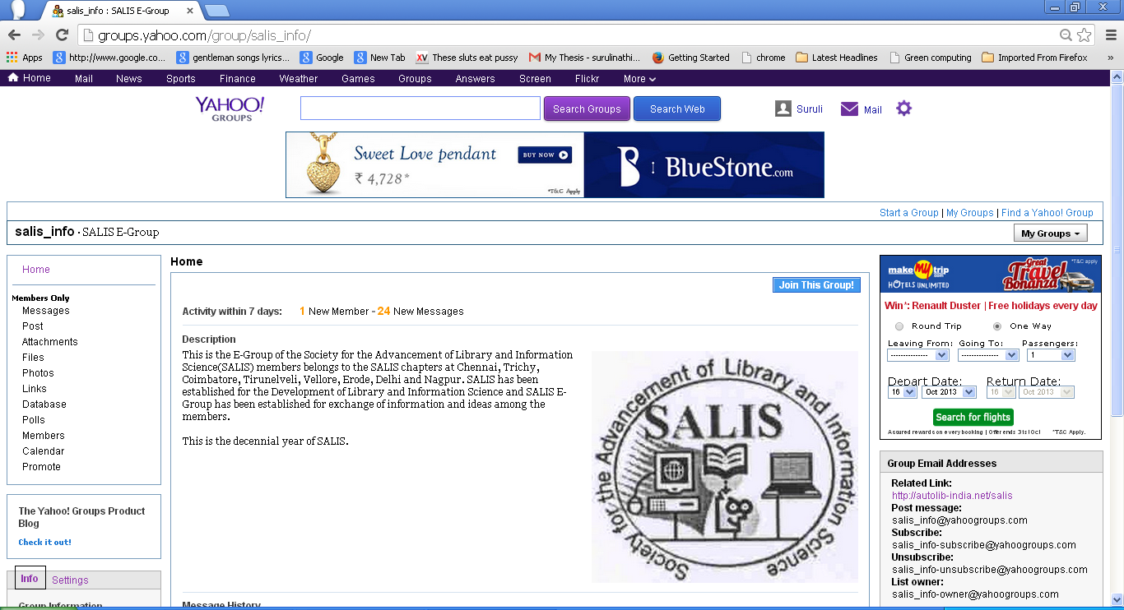
Group mail for discussion

Slide 80
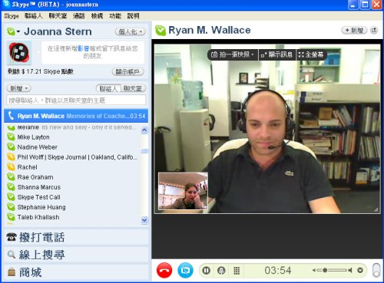
Skype for Chat

Slide 81
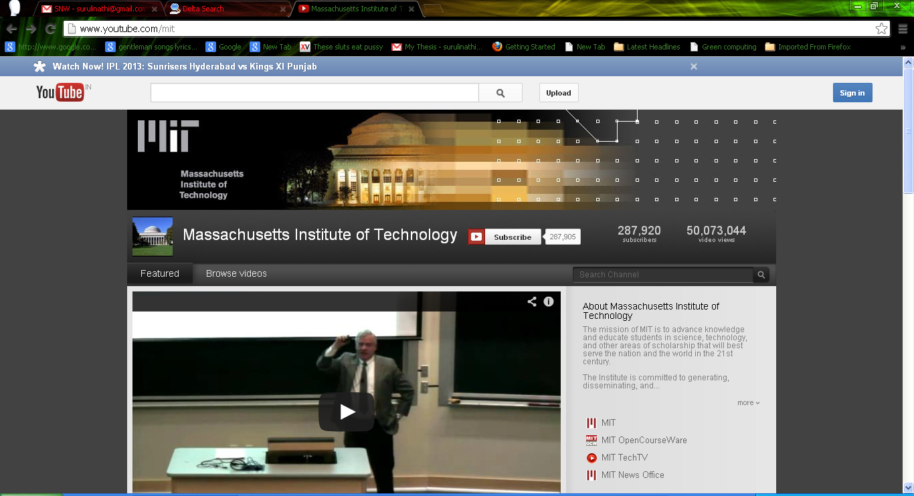
YOU TUBE
The mission of MIT is to advance knowledge and educate students in science, technology, and other areas of scholarship that will best serve the nation.
YouTube is a video-sharing website on which users can upload, share, and view videos.

Slide 82
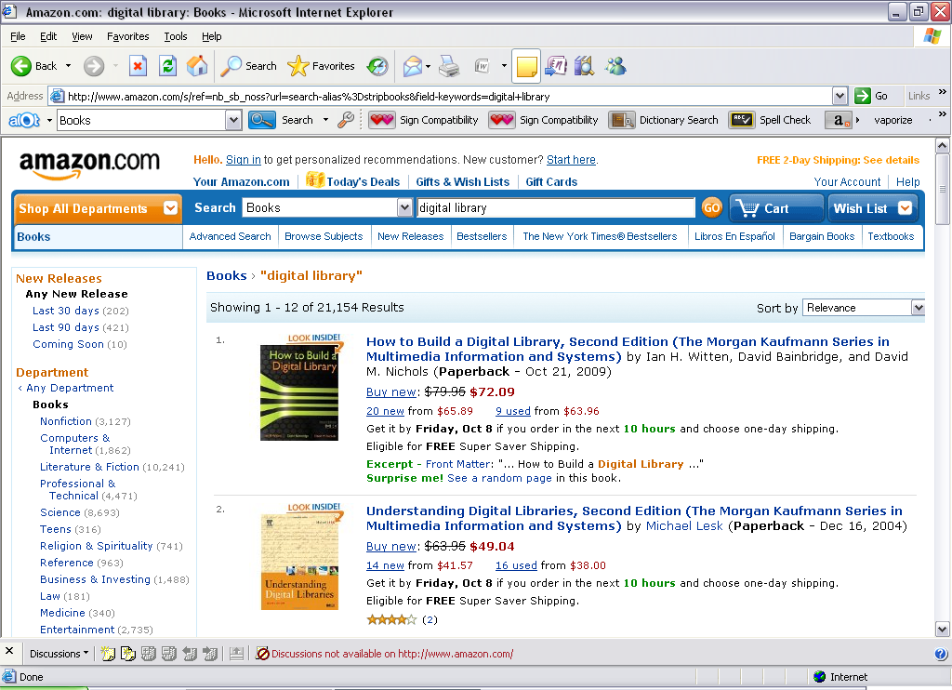
AMAZON
Online shopping for millions of new & used books on thousands of topics at everyday low prices.

Slide 83
Difference Between Web 1.0, Web 2.0
S. No. | Web 1.0 | Web 2.0 | Web 3.0
1. | Mostly Read-Only | Wildly Read-Write | Portable and Personal
2. | Company Focus | Community Focus | Individual Focus
3. | Home Pages | Blogs / Wikis | Live-streams / Waves
4. | Owning Content | Sharing Content | Consolidating Content
5. | WebForms | Web Applications | Smart Applications
6. | Directories | Tagging | User behavior
7. | Page Views | Cost Per Click | User Engagement
8. | Banner Advertising | Interactive Advertising | Behavioral Advertising
9. | Britannica Online | Wikipedia | The Semantic Web
10. | HTML/Portals | XML / RSS | RDF / RDFS / OWL

Slide 84
S. No. | Web 1.0 | Web 2.0 | Web 3.0
11. | Data was not Focused. | Data of many was controlled by some mediatory. | Data was personalized and no use of mediatory.
12. | Information sharing is the goal. | Interaction is the goal. | Immersion is the goal.
13. | It connects information as its primary goal. | It aims to connect people. | Focuses on relating knowledge.
14. | Static websites | Introduction of web applications | Intelligent web-based functions and apps
15. | A simpler, more passive web. | An enhanced social Web | A semantic web exists.
16. | Web and File Servers, HTML, and Portals are technologies connected to Web 1.0. | AJAX, JavaScript, CSS, and HTML5 are examples of related technology. | Web 3.0 technologies include blockchain, artificial intelligence, and decentralized protocols.
17. | Associated Technologies Web and File Servers Search Engines (including AltaVista and Yahoo!) E-mail accounts (Yahoo!, Hotmail) Peer-to-Peer File Sharing (Napster, BitTorrent) and others. | Associated Technologies Frameworks for Ajax and JavaScript Microsoft.NET Blogs Wikis and others. | Associated Technologies Searching Using Semantics Databases of Information Ontologies Intelligent Digital Personal Assistants and others.

Slide 85


